Slide 1
Software Design Specification
for
Vacation Tracking System
Aimee Valladares | Yuki Lieu | Ramnik Bharath
CEN 4065 | Fall 2021

Slide 2
Agenda
01 -
02 -
03 -
04 -
Introduction & Design Considerations
High-Level Architecture
Detailed System Design
User Interface Design

Slide 3
Introduction
The Vacation Tracking System (VTS) allows employees to efficiently manage:
Vacation time
Sick leave
Personal time
The system will utilize:
A rules-based validation system
A notification system
Integrate with existing systems
Multiple interfaces for the various personnel, departments, and systems

Slide 4
Design Considerations
Assumptions:
Should be a simple process
For the user to send in a vacation request from an app or website.
Should have block off days
If too many employees request the same day off in the calendar.
Linked to an employee calendar that shows who has P.T.O or is on vacation.
Goes through a hierarchy scale
with the flowchart approval process.
General Constraints:
Limited to the functionalities of VTS application.
Running the application through the employer’s network/vpn if at home.
Verifying the user before allowing a request to be sent.
Ensuring user cannot ask for more P.T.O then what is given.
Following flowchart hierarchy.

Slide 5
02 High-Level Architecture

Slide 6
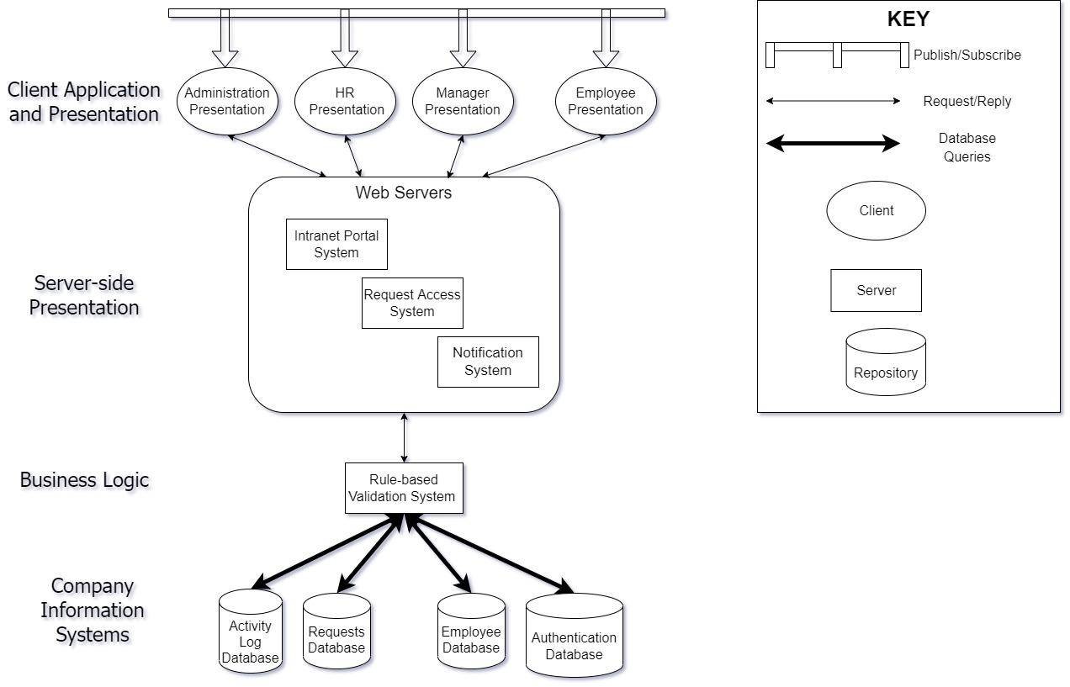
System Architecture

Slide 7
Major Design Issues
Reliability
Performance
Maintainability
Security

Slide 8
03 Detailed System Design

Slide 9
Activity Diagrams
Login
Accessing Previous Leave Time Requests
Requesting Leave Time
Approving Leave Time Request
Award Personal Leave Time
Override Actions
Retrieving Employee Information and Changes

Slide 10
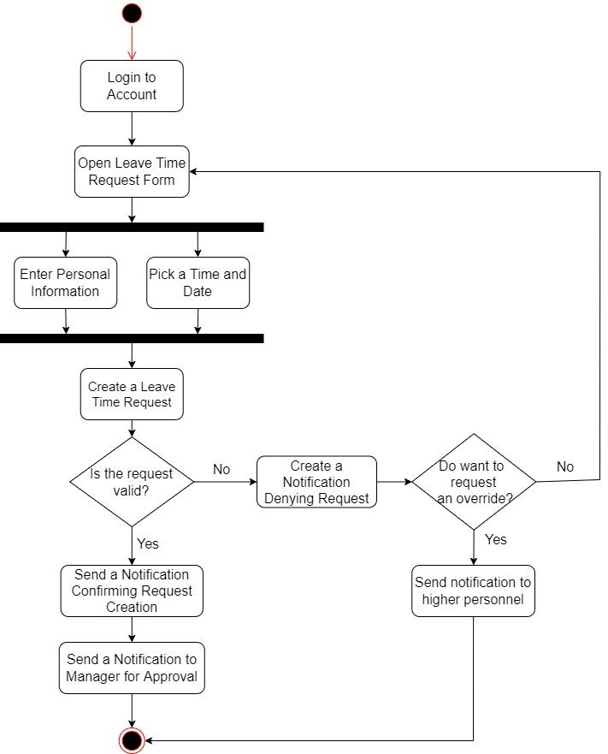
Activity Diagram - Requesting Leave Time

Slide 11
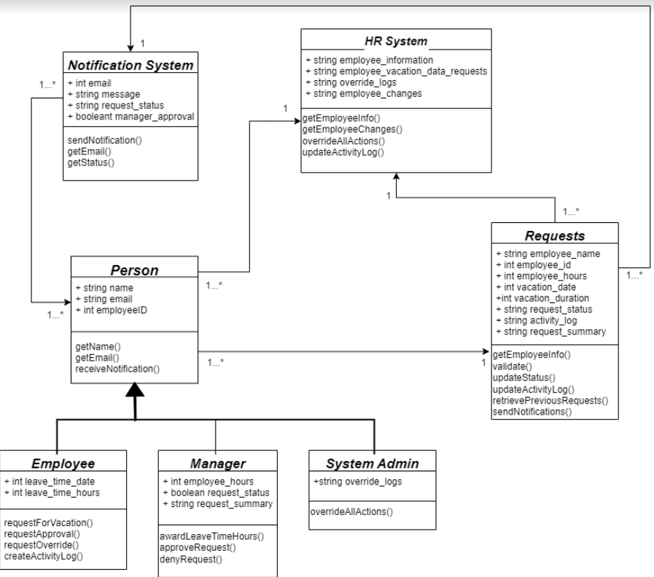
Class Diagram

Slide 12
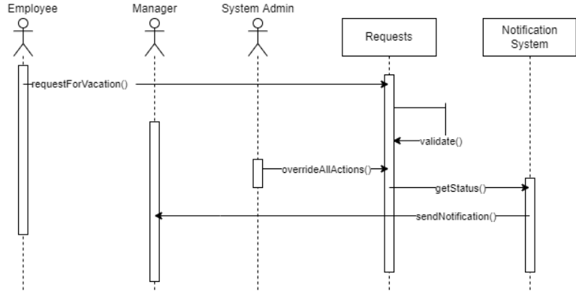
Message Sequence Diagram - Requesting Leave Time

Slide 13
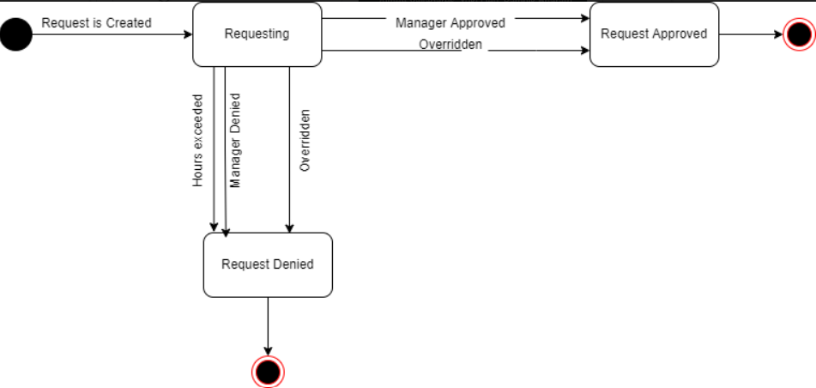
UML Statechart Diagram

Slide 14
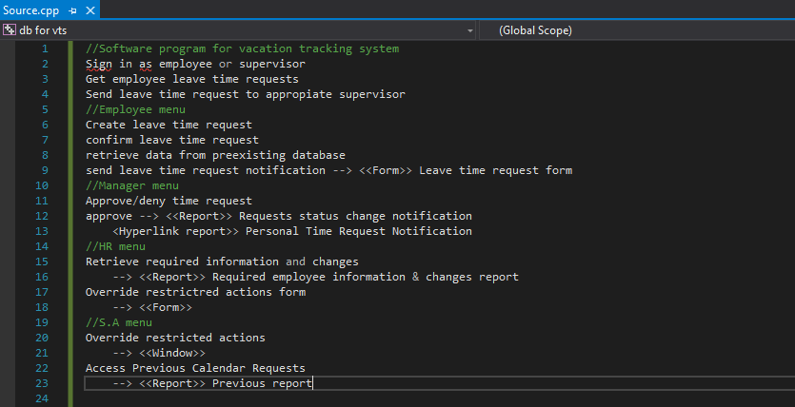
Algorithms for Components/Methods

Slide 15
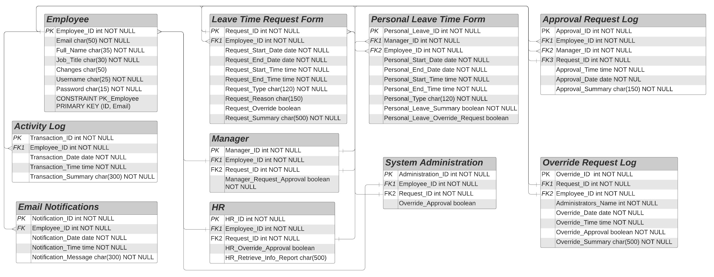
Database Design

Slide 16
04 User Interface Design

Slide 17
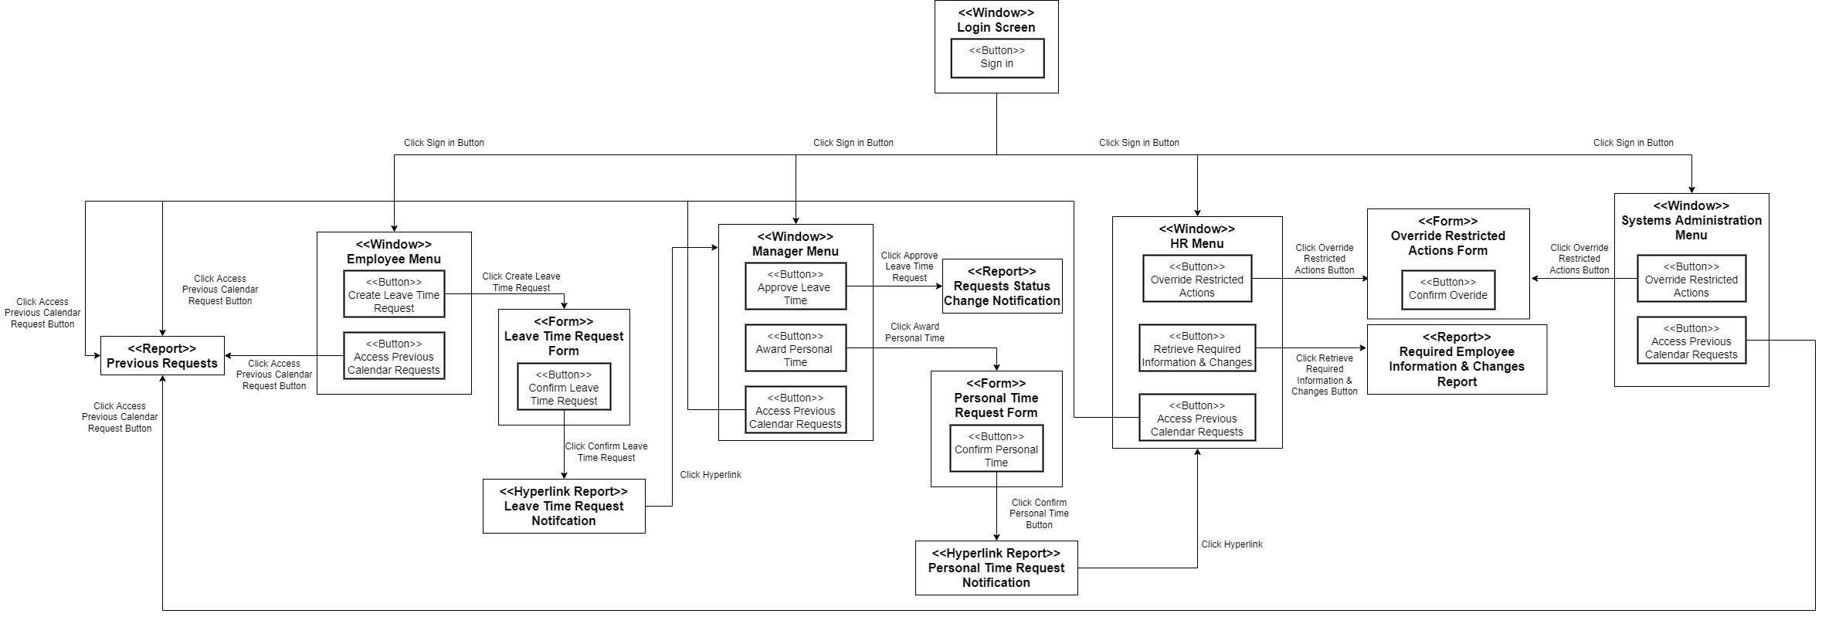
Windows Navigation Diagram

Slide 18
Windows Navigation Diagram

Slide 19
Windows Navigation Diagram

Slide 20
Windows Navigation Diagram

Slide 21
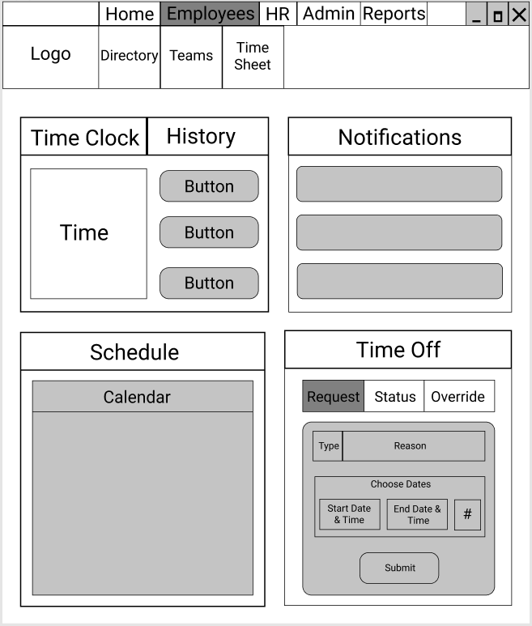
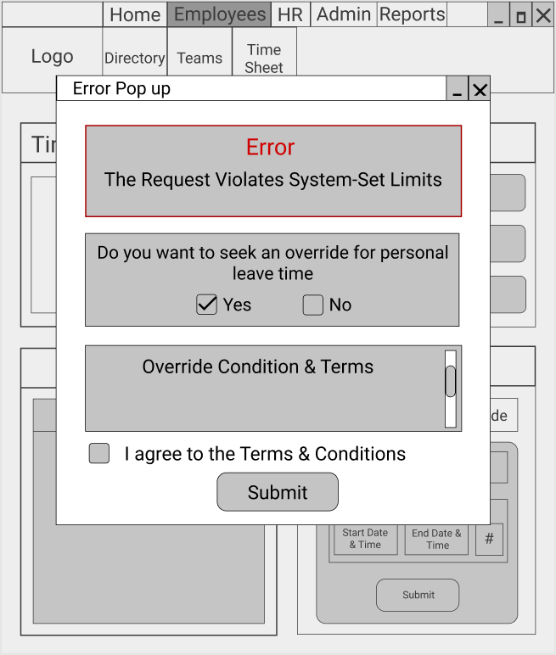
User Interface Wireframes

Slide 22
Thank you for your time!
Any Questions?

